Slide 1

OOP Presentation
Presented By Invincible Squad

Slide 2



Our Team
Waleed Ashraf
Muneeb Ahmed
Ahmed Shahbaz
bcsm-s21-011
bcsm-s21-047
bcsm-s21-022

Slide 3
TOPICS
Operator Overloading
Operator Overloading As
Member Function
Friend Classes And
Functions
=
/
+
Operator Overloading As
Friend Function
Arithmetic Assignment
Operators
File Handling

Slide 4

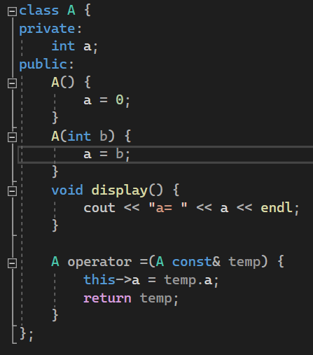
Operator Overloading
To perform binary operations between the objects of classes we uses operator overloading. When we define a operator overloading method within the class it’s also known as operator overloading as member function.
Syntax:
class ClassName {
public:
ReturnType operator Symbol(Arguments) {
return type
}
};
Program:
Open Code

Slide 5
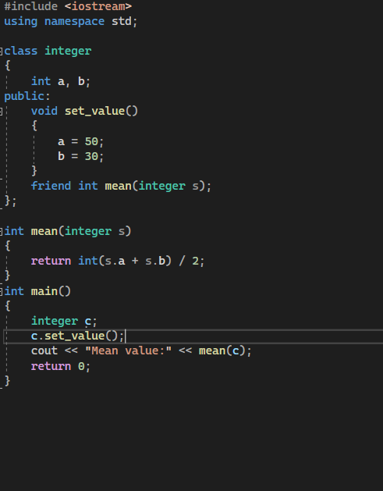
Friend Classes & Functions
A friend function in C++ is defined as a function that can access private, protected and public members of a class. The friend function is declared using the friend keyword inside the body of the class.
Syntax:
class ClassName {
public:
ReturnType operator Symbol(Arguments) {
return type
}
};
Programs:
Friend Class
Friend Function

Slide 6
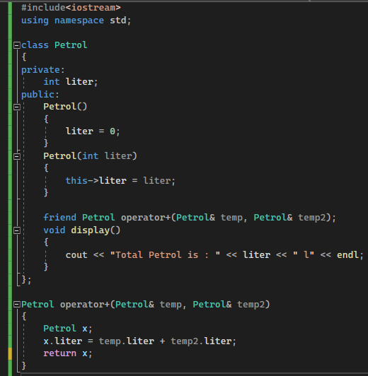
Operator Overloading As Friend Function
In operator overloading as friend function we defines operator overloaded function outside the class and makes it friend of that class as we did in friend function and friend classes.
Syntax:
class ClassName {
public:
friend ReturnType operator Symbol(Arguments); };
ReturnType operator Symbol(Arguments)
{
return type
}
Program:
Open Code

Slide 7

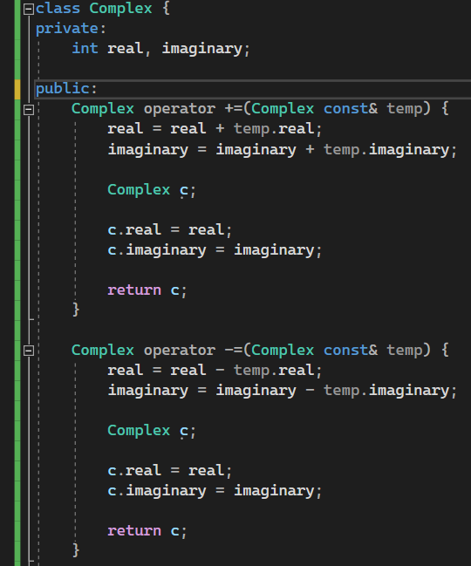
Arithmetic Assignment Operators Overloading
+=, -=, *= are arithmetic assignment operators. These operators are also known as complex operators.
We can overload arithmetic assignment operators same as we do for arithmetic operators (+, - , * , / ).
Syntax:
class ClassName {
public:
ReturnType operator Symbol(Arguments) {
return type
}
};
Program:
Open Code

Slide 8
File Handling
Program Output.
RAM.
File Handling.
File Manager and File Explorers.
<iostream> for I/O methods.
<fstream> for ifstream, ofstream, fstream methods.
After closing the program, user will unable to read again that program output just because at that time program was saved in RAM so after closing the program, all the data related to that program execution also get deleted from RAM.
But now we can do it via file handling in C++. Using file handling we can save our program output directly to computer storage can read it whenever we want.
C++ provide us a default hederal file to perform this action named “<fstream>”. As “iostream” provide us cin and cout methods for input and output respectively, “<fstream>” provide us ifstream for reading purposes, ofstream for writing purposes, and fstream that provide us both reading and writing modes.
Open File
Write File
Append
Read File
Close File

Slide 9
File Handling(File Opening Modes)
While opening a file another important thing is in which mode the file is opened. Here are the common modes to open a file:
File Mode | Meaning | Explanation
ios::in | Read | For reading purpose only. Generates error if doesn’t exists.
ios::out | Write | For reading purpose only. Automatically create a new file if doesn’t exits.
ios::app | Appending | Open in reading mode but pointer starts from the end of file.
ios::trunc | Truncate/Discard | This mode delete all the data from a file.

Slide 10
File Handling
Syntaxes:
General:
file_object.open("FileName.Extension", ios::OpenMode);
Writing:
file_object.open("FileName.Extension", ios::out);
file_object << "White This In File";
Reading:
file_object.open("FileName.Extension", ios::in);
while (file_object.eof()) {
char ch;
file_object.get(ch);
cout << ch;
}
Appending:
file_object.open("FileName.Extension", ios::app);
Deleting Data:
file_object.open("FileName.Extension", ios::out | ios::trunc);
Close File:
file_object.close();
Open Code

Slide 11
THANK YOU!

